Slide 1
IT304 Computer Networks
Week3_Lec3_ApplicationLayer-II

Slide 2

E-mail
user
agent
Three major components:
user agents
mail servers
simple mail transfer protocol: SMTP
User Agent
a.k.a. “mail reader”
composing, editing, reading mail messages
e.g., Outlook, iPhone mail client
outgoing, incoming messages stored on server
mail
server
user
agent
SMTP
mail
server
user
agent
SMTP
SMTP
user
agent
mail
server
user
agent
user
agent
outgoing
message queue
user mailbox

Slide 3
E-mail: mail servers
user
agent
mail servers:
mailbox contains incoming messages for user
message queue of outgoing (to be sent) mail messages
SMTP protocol between mail servers to send email messages
client: sending mail server
“server”: receiving mail server
mail
server
user
agent
SMTP
mail
server
user
agent
SMTP
SMTP
user
agent
mail
server
user
agent
user
agent
outgoing
message queue
user mailbox

Slide 4
SMTP RFC (5321)
“client”
SMTP server
“server”
SMTP server
uses TCP to reliably transfer email message from client (mail server initiating connection) to server, port 25
direct transfer: sending server (acting like client) to receiving server
three phases of transfer
SMTP handshaking (greeting)
SMTP transfer of messages
SMTP closure
command/response interaction (like HTTP)
commands: ASCII text
response: status code and phrase
initiate TCP
connection
RTT
TCP connection
initiated
220
SMTP handshaking
HELO
250 Hello
SMTP transfers
time

Slide 5


Scenario: Alice sends e-mail to Bob
1) Alice uses UA to compose e-mail message “to” bob@someschool.edu
4) SMTP client sends Alice’s message over the TCP connection
2) Alice’s UA sends message to her mail server using SMTP; message placed in message queue
5) Bob’s mail server places the message in Bob’s mailbox
3) client side of SMTP at mail server opens TCP connection with Bob’s mail server
6) Bob invokes his user agent to read message
user
agent
mail
server
user
agent
1
mail
server
2
3
6
4
Alice’s mail server
5
Bob’s mail server

Slide 6
Sample SMTP interaction
S: 220 hamburger.edu
C: HELO crepes.fr
S: 250 Hello crepes.fr, pleased to meet you
C: MAIL FROM: <alice@crepes.fr>
S: 250 alice@crepes.fr... Sender ok
C: RCPT TO: <bob@hamburger.edu>
S: 250 bob@hamburger.edu ... Recipient ok
C: DATA
S: 354 Enter mail, end with "." on a line by itself
C: Do you like ketchup?
C: How about pickles?
C: .
S: 250 Message accepted for delivery
C: QUIT
S: 221 hamburger.edu closing connection

Slide 7
SMTP: observations
comparison with HTTP:
HTTP: client pull
SMTP: client push
both have ASCII command/response interaction, status codes
HTTP: each object encapsulated in its own response message
SMTP: multiple objects sent in multipart message
SMTP uses persistent connections
SMTP requires message (header & body) to be in 7-bit ASCII
SMTP server uses CRLF.CRLF to determine end of message

Slide 8
Mail message format
SMTP: protocol for exchanging e-mail messages, defined in RFC 5321 (like RFC 7231 defines HTTP)
RFC 2822 defines syntax for e-mail message itself (like HTML defines syntax for web documents)
header lines, e.g.,
To:
From:
Subject:
these lines, within the body of the email message area different from SMTP MAIL FROM:, RCPT TO: commands!
Body: the “message” , ASCII characters only
header
blank
line
body

Slide 9

Retrieving email: mail access protocols
user
agent
e-mail access
protocol
user
agent
SMTP
SMTP
(e.g., IMAP, HTTP)
sender’s e-mail
server
receiver’s e-mail
server
SMTP: delivery/storage of e-mail messages to receiver’s server
mail access protocol: retrieval from server
IMAP: Internet Mail Access Protocol [RFC 3501]: messages stored on server, IMAP provides retrieval, deletion, folders of stored messages on server
HTTP: gmail, Hotmail, Yahoo!Mail, etc. provides web-based interface on top of STMP (to send), IMAP (or POP) to retrieve e-mail messages

Slide 10
DNS: Domain Name System
people: many identifiers:
SSN, name, passport #
Internet hosts, routers:
IP address (32 bit) - used for addressing datagrams
“name”, e.g., cs.umass.edu - used by humans
Q: how to map between IP address and name, and vice versa ?
Domain Name System (DNS):
distributed database implemented in hierarchy of many name servers
application-layer protocol: hosts, DNS servers communicate to resolve names (address/name translation)
note: core Internet function, implemented as application-layer protocol
complexity at network’s “edge”

Slide 11
DNS: services, structure
DNS services:
hostname-to-IP-address translation
host aliasing
canonical, alias names
mail server aliasing
load distribution
replicated Web servers: many IP addresses correspond to one name
Q: Why not centralize DNS?
single point of failure
traffic volume
distant centralized database
maintenance
A: doesn‘t scale!
Comcast DNS servers alone: 600B DNS queries/day
Akamai DNS servers alone: 2.2T DNS queries/day

Slide 12

Thinking about the DNS
humongous distributed database:
~ billion records, each simple
handles many trillions of queries/day:
many more reads than writes
performance matters: almost every Internet transaction interacts with DNS - msecs count!
organizationally, physically decentralized:
millions of different organizations responsible for their records
“bulletproof”: reliability, security

Slide 13

DNS: a distributed, hierarchical database
Root DNS Servers
Root
…
…
.com DNS servers
.org DNS servers
.edu DNS servers
Top Level Domain
…
…
…
…
yahoo.com
DNS servers
amazon.com
DNS servers
pbs.org
DNS servers
nyu.edu
DNS servers
umass.edu
DNS servers
Authoritative
Client wants IP address for www.amazon.com; 1st approximation:
client queries root server to find .com DNS server
client queries .com DNS server to get amazon.com DNS server
client queries amazon.com DNS server to get IP address for www.amazon.com

Slide 14
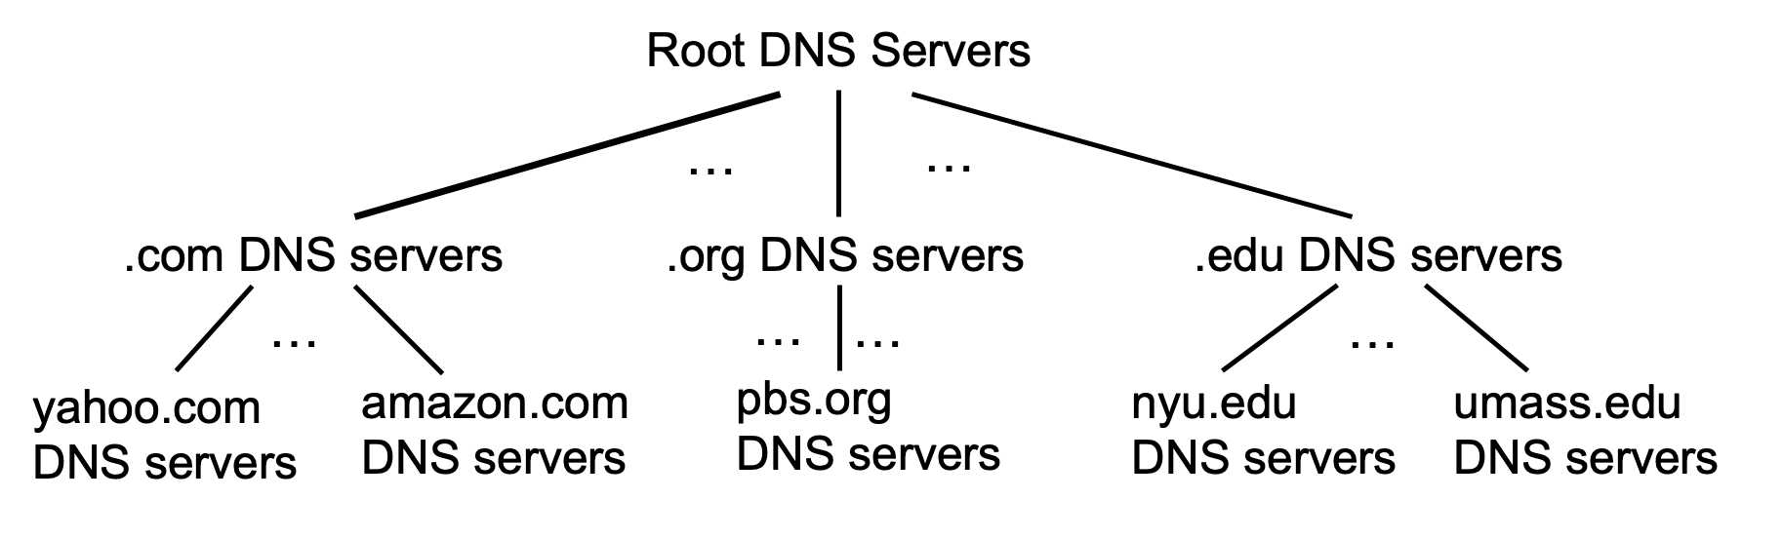
DNS: root name servers
official, contact-of-last-resort by name servers that can not resolve name

Slide 15
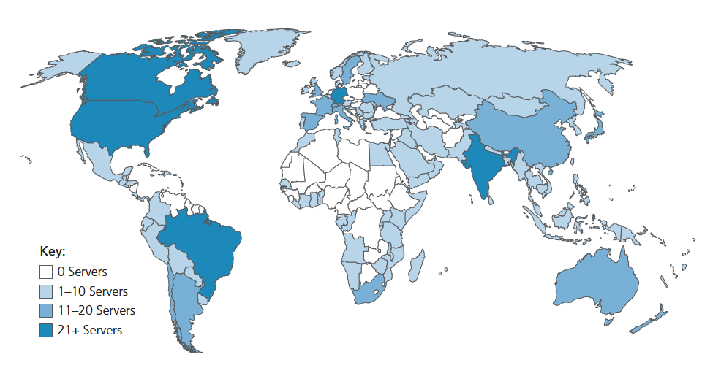
DNS: root name servers
official, contact-of-last-resort by name servers that can not resolve name
incredibly important Internet function
Internet couldn’t function without it!
DNSSEC – provides security (authentication, message integrity)
ICANN (Internet Corporation for Assigned Names and Numbers) manages root DNS domain
13 logical root name “servers” worldwide each “server” replicated many times (~200 servers in US)

Slide 16
Top-Level Domain, and authoritative servers
Top-Level Domain (TLD) servers:
responsible for .com, .org, .net, .edu, .aero, .jobs, .museums, and all top-level country domains, e.g.: .cn, .uk, .fr, .ca, .jp
Network Solutions: authoritative registry for .com, .net TLD
Educause: .edu TLD
authoritative DNS servers:
organization’s own DNS server(s), providing authoritative hostname to IP mappings for organization’s named hosts
can be maintained by organization or service provider

Slide 17
Local DNS name servers
when host makes DNS query, it is sent to its local DNS server
Local DNS server returns reply, answering:
from its local cache of recent name-to-address translation pairs (possibly out of date!)
forwarding request into DNS hierarchy for resolution
each ISP has local DNS name server; to find yours:
MacOS: % scutil --dns
Windows: >ipconfig /all
local DNS server doesn’t strictly belong to hierarchy

Slide 18
DNS name resolution: iterated query
root DNS server
Example: host at engineering.nyu.edu wants IP address for gaia.cs.umass.edu
2
3
TLD DNS server
Iterated query:
contacted server replies with name of server to contact
“I don’t know this name, but ask this server”
1
4
8
5
requesting host at
engineering.nyu.edu
local DNS server
dns.nyu.edu
gaia.cs.umass.edu
7
6
authoritative DNS server
dns.cs.umass.edu

Slide 19


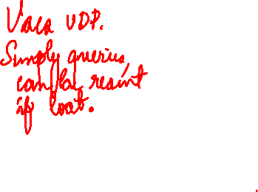
DNS name resolution: recursive query
root DNS server
Example: host at engineering.nyu.edu wants IP address for gaia.cs.umass.edu
2
3
7
6
Recursive query:
puts burden of name resolution on contacted name server
heavy load at upper levels of hierarchy?
1
TLD DNS server
8
requesting host at
engineering.nyu.edu
local DNS server
dns.nyu.edu
5
4
gaia.cs.umass.edu
authoritative DNS server
dns.cs.umass.edu

